Slide 1
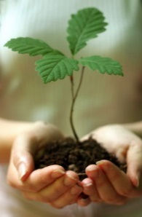
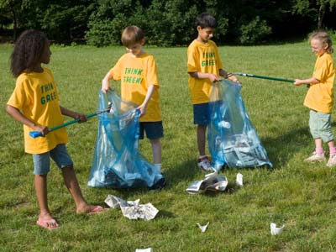
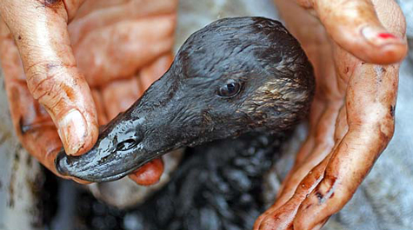
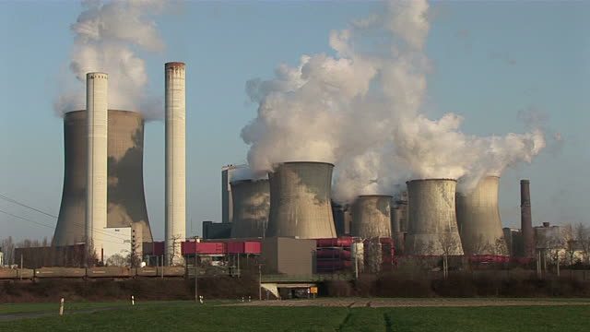
We need to look after our environment.
What do you think?
Do you agree?
Do you disagree?
Perhaps you can think of ideas for both sides.
Write to convince a reader of your opinions.
http://easyscienceforkids.com/wp-content/uploads/2014/02/All-about-Conservation-Fun-Earth-Science-Facts-for-Kids-Kids-Practicing-Conservation-by-Picking-Up-Trash.jpg
http://humanflowerproject.com/images/uploads2/oil-bird475.jpg http://cache2.asset-cache.net/xd/136818105.jpg?v=1&c=IWSAsset&k=2&d=F13A1F9190F00936CE6E97922A974B3C073A698A4A956D7852DF6A88F40E98B75E88A36A645039DA

Slide 2
We need to look after our environment.
Start with an introduction. An introduction lets the reader know what you are going to write about.
Write your opinions on this topic. Give reasons for your opinions. Explain your reasons.
Finish with a conclusion. A conclusion is a way to sum up your writing so that a reader is convinced of your opinions.
http://easyscienceforkids.com/wp-content/uploads/2014/02/All-about-Conservation-Fun-Earth-Science-Facts-for-Kids-Kids-Practicing-Conservation-by-Picking-Up-Trash.jpg
http://humanflowerproject.com/images/uploads2/oil-bird475.jpg http://cache2.asset-cache.net/xd/136818105.jpg?v=1&c=IWSAsset&k=2&d=F13A1F9190F00936CE6E97922A974B3C073A698A4A956D7852DF6A88F40E98B75E88A36A645039DA

Slide 3
We need to look after our environment.
Remember to:
plan your story before you start
write in sentences
pay attention to the words you choose, your spelling and punctuation, and paragraphs
check and edit your writing when you are finished.
http://easyscienceforkids.com/wp-content/uploads/2014/02/All-about-Conservation-Fun-Earth-Science-Facts-for-Kids-Kids-Practicing-Conservation-by-Picking-Up-Trash.jpg
http://humanflowerproject.com/images/uploads2/oil-bird475.jpg http://cache2.asset-cache.net/xd/136818105.jpg?v=1&c=IWSAsset&k=2&d=F13A1F9190F00936CE6E97922A974B3C073A698A4A956D7852DF6A88F40E98B75E88A36A645039DA

