Slide 1
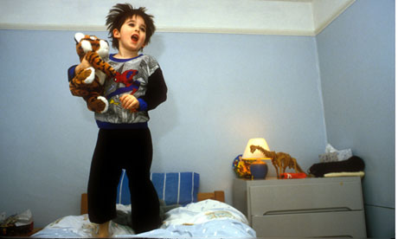
Children should have a set bedtime.
What do you think?
Do you agree?
Do you disagree?
Perhaps you can think of ideas for both sides.
Write to convince a reader of your opinions.
http://img.webmd.boots.com/dtmcms/live/webmd_uk/consumer_assets/site_images/articles/health_tools/top_reasons_your_child_cant_sleep_slideshow/getty_rm_photo_of_little_girl_sleeping_at_school.jpghttp://nspt4kids.com/wp-content/uploads/2013/07/bedtime.jpg
http://static.guim.co.uk/sys-images/Guardian/Pix/pictures/2013/2/12/1360679121955/Boy-jumping-on-the-bed-010.jpg

Slide 2
Children should have a set bedtime.
Start with an introduction. An introduction lets the reader know what you are going to write about.
Write your opinions on this topic. Give reasons for your opinions. Explain your reasons.
Finish with a conclusion. A conclusion is a way to sum up your writing so that a reader is convinced of your opinions.
http://img.webmd.boots.com/dtmcms/live/webmd_uk/consumer_assets/site_images/articles/health_tools/top_reasons_your_child_cant_sleep_slideshow/getty_rm_photo_of_little_girl_sleeping_at_school.jpghttp://nspt4kids.com/wp-content/uploads/2013/07/bedtime.jpg
http://static.guim.co.uk/sys-images/Guardian/Pix/pictures/2013/2/12/1360679121955/Boy-jumping-on-the-bed-010.jpg

Slide 3
Children should have a set bedtime.
Remember to:
plan your story before you start
write in sentences
pay attention to the words you choose, your spelling and punctuation, and paragraphs
check and edit your writing when you are finished.
http://img.webmd.boots.com/dtmcms/live/webmd_uk/consumer_assets/site_images/articles/health_tools/top_reasons_your_child_cant_sleep_slideshow/getty_rm_photo_of_little_girl_sleeping_at_school.jpghttp://nspt4kids.com/wp-content/uploads/2013/07/bedtime.jpg
http://static.guim.co.uk/sys-images/Guardian/Pix/pictures/2013/2/12/1360679121955/Boy-jumping-on-the-bed-010.jpg

