Slide 1
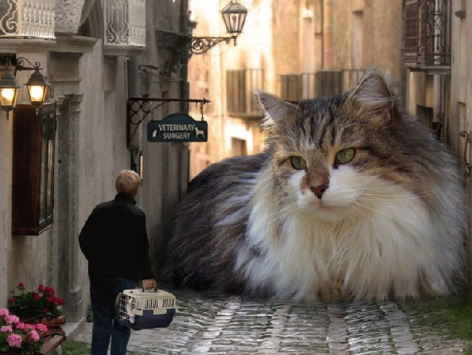
Today you are going to write a narrative or story.
Part of your idea is this giant cat with the man in front of the veterinary clinic.
Who is the man?
Why is he there?
What happened to the
cat?
How did it happen?
What happens next?
http://crispyclicks.com/wp-content/uploads/2012/12/giant-people-giant-animal-images-2.jpg

Slide 2
Think about:
the characters and where they are
the complication or problem to be solved
how the story will end.
Remember to:
plan your story before
you start
write in sentences
pay attention to the
words you choose,
your spelling and
punctuation, and
paragraphs
check and edit your
writing when you are
finished.
http://crispyclicks.com/wp-content/uploads/2012/12/giant-people-giant-animal-images-2.jpg

