Slide 1
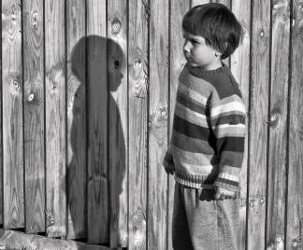
Today you are going to write a narrative or story.
Part of your idea is this boy’s invisible friend, have a look at his shadow.
Who is the boy?
Who is his invisible friend?
Can anyone else see the
boy’s friend?
Why does the boy have
an invisible friend?
What happens next?
http://3.bp.blogspot.com/_iq2vQY1Jeaw/TS9NmDjG5QI/AAAAAAAAXOA/5AsboQQpspY/s1600/imaginary_friend.jpg

Slide 2
Think about: - The characters and where they are - The complication or problem to be solved - How the story will end. Remember to: - Plan your story before you start - Write in sentences - Pay attention to the words you choose, your spelling and punctuation, and paragraphs - Check and edit your writing when you are finished.
http://3.bp.blogspot.com/_iq2vQY1Jeaw/TS9NmDjG5QI/AAAAAAAAXOA/5AsboQQpspY/s1600/imaginary_friend.jpg

