Slide 1
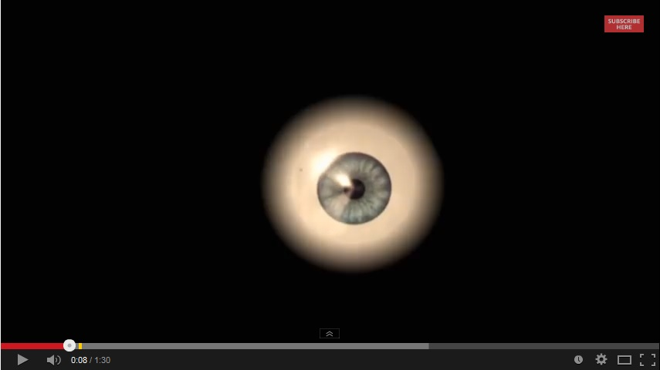
Today you are going to write a narrative or story.
Part of your idea is this video about a boy who is frightened of how he looks.
Who is the boy?
Why is he so frightened?
What was he thinking?
This is just the beginning……
What happens next?

Slide 2
Think about:
the characters and where they are
the complication or problem to be solved
how the story will end.
Remember to:
plan your story before
you start
write in sentences
pay attention to the
words you choose,
your spelling and
punctuation, and
paragraphs
check and edit your
writing when you are
finished.

