Slide 1
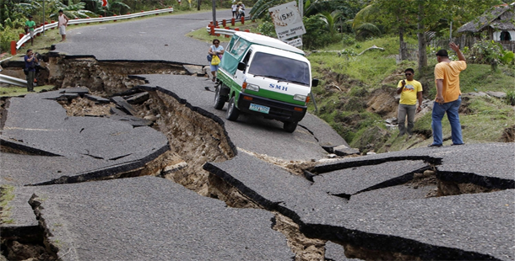
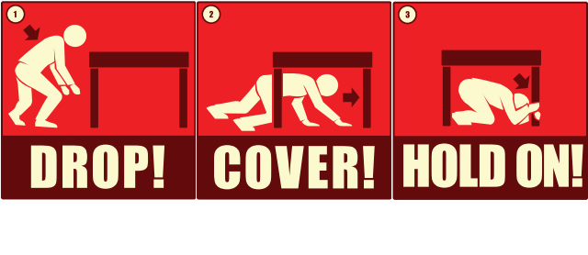
Informative text
earthquakes
Start with an introduction.
An introduction lets the reader know what you are going to write about.
Write your facts on this topic.
Explain each fact by giving supporting statements. A diagram may help.
Finish with a conclusion.
A conclusion is a way to sum up your writing.
http://cdn2.list25.com/wp-content/uploads/2013/05/earthquake.png
http://www.cdc.gov/disasters/earthquakes/images/dropcoverholdon-481px.png

Slide 2
Informative text
earthquakes
Remember to:
Plan your story before
you start
Write in sentences
Pay attention to the
words you choose, your
spelling and punctuation,
and paragraphs
Check and edit your writing when you are finished.
http://cdn2.list25.com/wp-content/uploads/2013/05/earthquake.png
http://www.cdc.gov/disasters/earthquakes/images/dropcoverholdon-481px.png

